Slide 1

Playwright Test Organization
Master grouping, hooks, annotations, and tags to build efficient, maintainable test suites that scale with your application.

Slide 2

Grouping Tests with test.describe()
Purpose & Benefits
Organize related tests by feature, page, or functionality for better structure and maintainability.
test.describe('Group1', () => { test('test1', async ({ page }) => { // test logic }); test('test2', async ({ page }) => { // test logic });});
Running Commands
All tests: npx playwright test tests/grouping.spec.ts
Specific group: --grep Group1

Slide 3
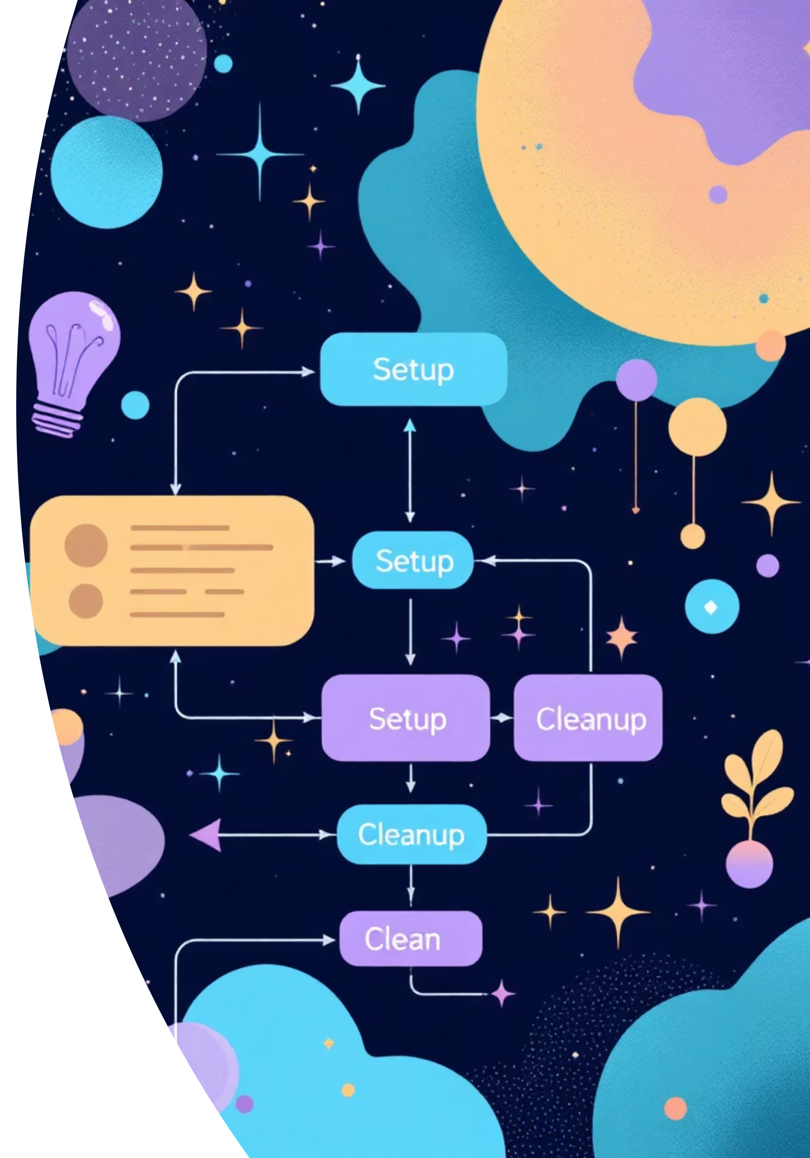
Playwright Hooks Overview
Setup & Cleanup
Hooks manage test environments, initialize resources, and clean up after execution for consistent test runs.
Four Main Types
beforeAll, afterAll, beforeEach, and afterEach provide precise control over when setup and cleanup occur.

Slide 4
Hook Types & Usage
01
02
beforeAll()
afterAll()
Runs once before all tests. Initialize shared resources like launching browsers or setting up test data.
Runs once after all tests. Clean up resources like closing browsers or deleting test data.
03
04
beforeEach()
afterEach()
Runs before each test. Set up fresh state like opening new pages or logging into applications.
Runs after each test. Clean up like closing pages or clearing local storage.

Slide 5



Test Annotations
Control how and when tests run during development, debugging, and handling flaky or incomplete tests.
test.only()
test.skip()
test.fail()
Runs only this test, skipping all others. Perfect for debugging specific test cases.
Skips the test entirely. Shows as skipped in results. Use for incomplete tests.
Marks test as expected to fail. Highlights unexpected success for known issues.

Slide 6

Additional Annotations
test.fixme()
Marks tests needing fixes. Automatically skipped. Great for tracking broken tests.
test.slow()
Increases timeout for long-running tests. Use for heavy computation or slow network requests.

Slide 7



Test Tags & Selective Execution
Tag tests (@sanity, @smoke, @regression) and run them selectively using grep commands.
test('@sanity @smoke Check title', async ({ page }) => { await page.goto('https://www.google.com/'); await expect(page).toHaveTitle('Google');});
Run Sanity Tests
Run Both Tags
Exclude Tags
--grep "@sanity"
--grep "(?=.*@sanity)(?=.*@regression)"
--grep-invert "@regression"

Slide 8







Key Takeaways
Organization
Control
Use describe() for grouping and hooks for setup/cleanup to maintain clean, organized test suites.
Leverage annotations like only(), skip(), and fail() for precise test execution control during development.
Efficiency
Implement tags to organize test suites and save time during development with selective test execution.

